Slide 1
Application of IoT
Prepare By:
Umang Garg
Assistant professor
Department of CSE

Slide 2

Application of IoT
Manufacturing / Industrial
Transportation / Mobility
Smart home
Wearables
Smart City
Connected Health (Digital health/Telehealth/Telemedicine)
Smart retail
Smart supply chain
Smart farming/agriculture

Slide 3
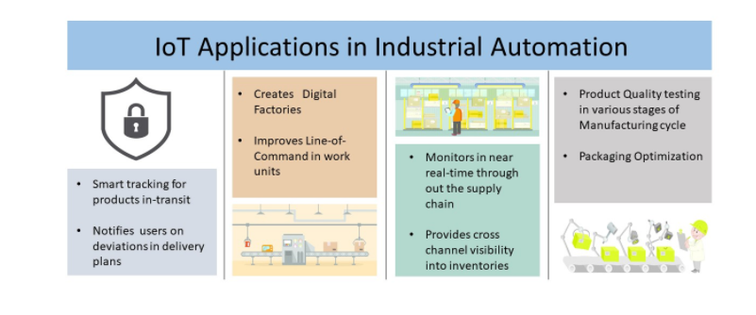
Industrial automation

Slide 4
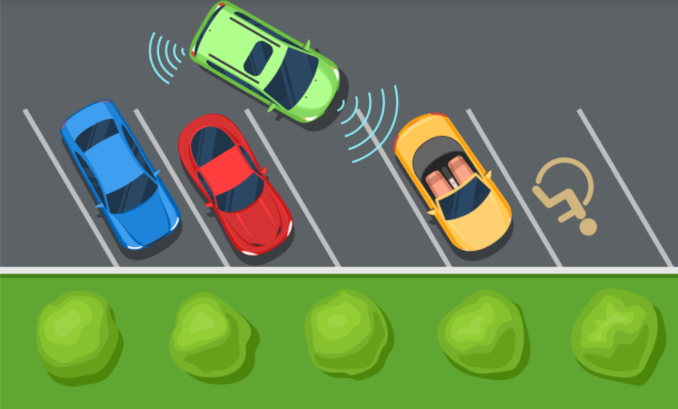
Smart City/Transportation and mobility

Slide 5
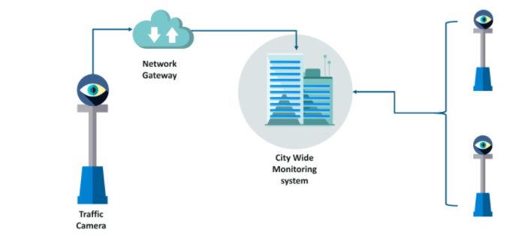
Smart traffic control
Smart transportation/smart traffic control

Slide 6
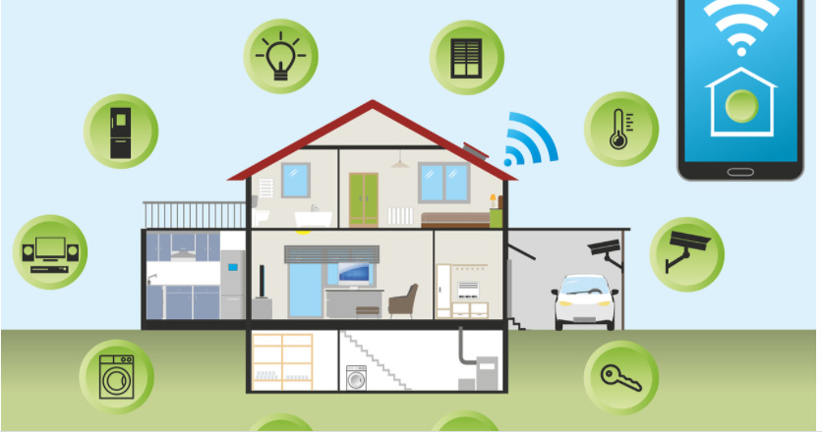
SMART Homes

Slide 7
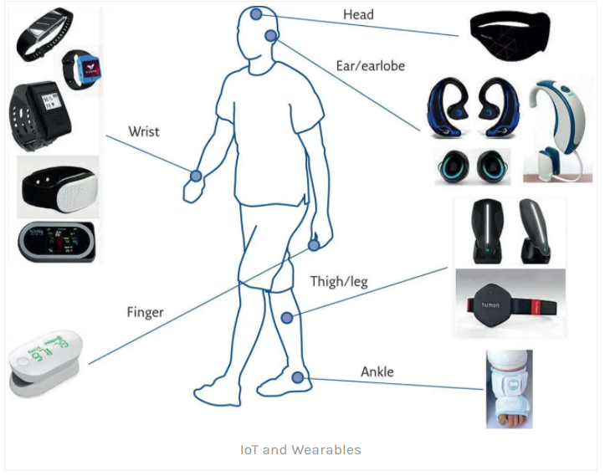
Wearables

Slide 8
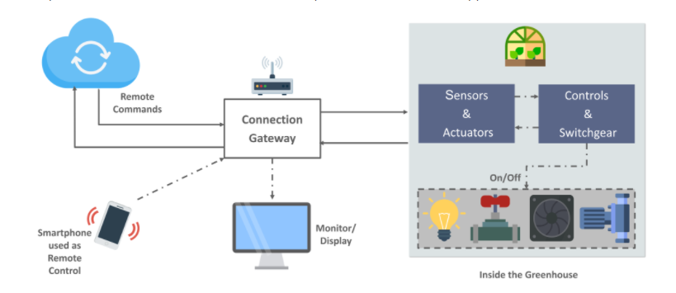
Smart agriculture

